Slide 1
Cheap Shop - Window Design
CmpE 496 HCI
Homework 2
Ufuk Arslan
2017400219
Oğuz Arslan
2017405180
04.04.2022

Slide 2



Tools Used
JavaScript as the programming language
React as the interface library
Ant Design as React UI library

Slide 3
Start Program
We need Node.js installed on our device. We can download and install Node.js from here. Once you download the project head over to the project folder and use commands below.
Setup Command
npm install
Wait for packages to download and install.
Run Command
npm start
Wait for project to open your browser at http://localhost:3000/.

Slide 4
How It Works?
Let’s say we are running a shop where we sell home furniture just like IKEA. We have a catalog of items, each having a unique code and different options to choose from. We want our customers to be able to purchase the furniture they want via our web application. We provide the catalog of the items to all our customers in our shop, and you can see a sample below.
Item Code | Item Name | Options | Base Price
1234567 | Kids Chair | 3 | 9.99$
111A111 | Book Shelf | 3 | 59.99$

Slide 5
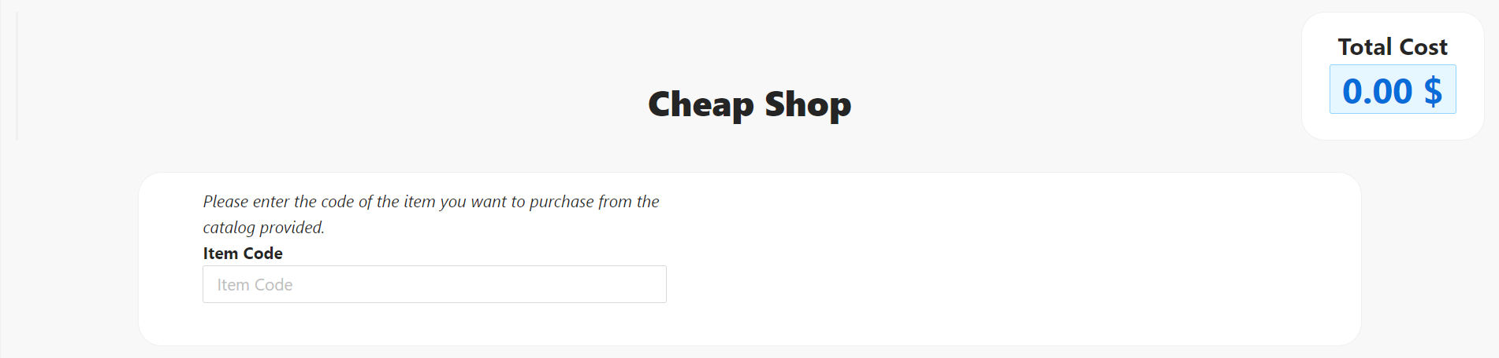
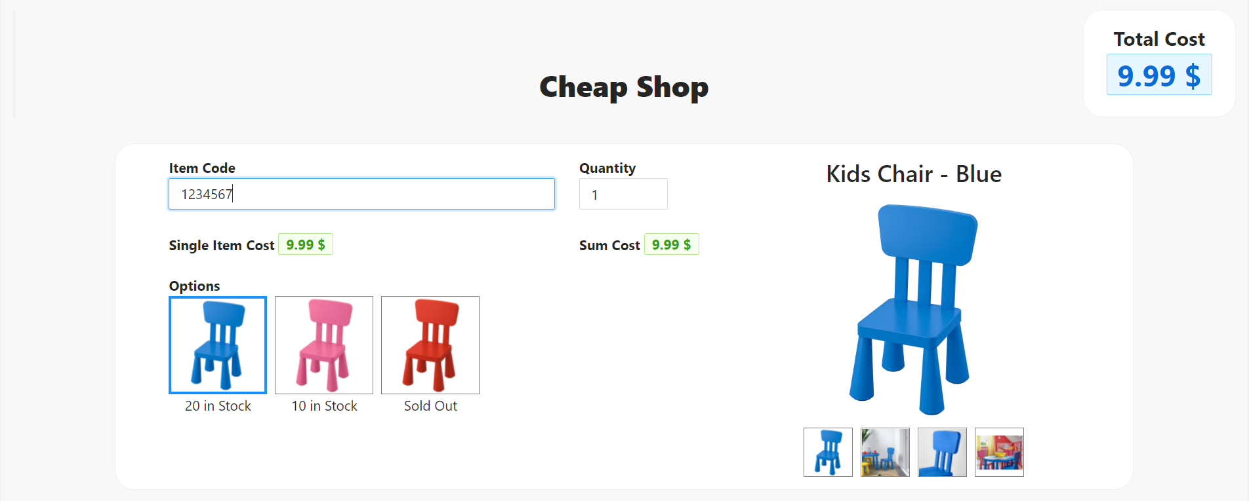
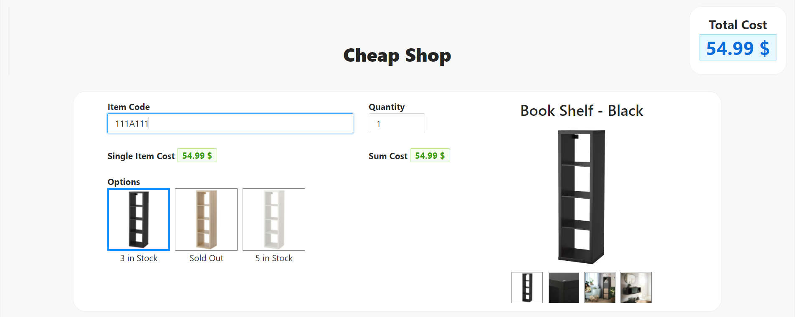
Selecting Items
We can select items by entering the codes in the catalog.

Slide 6
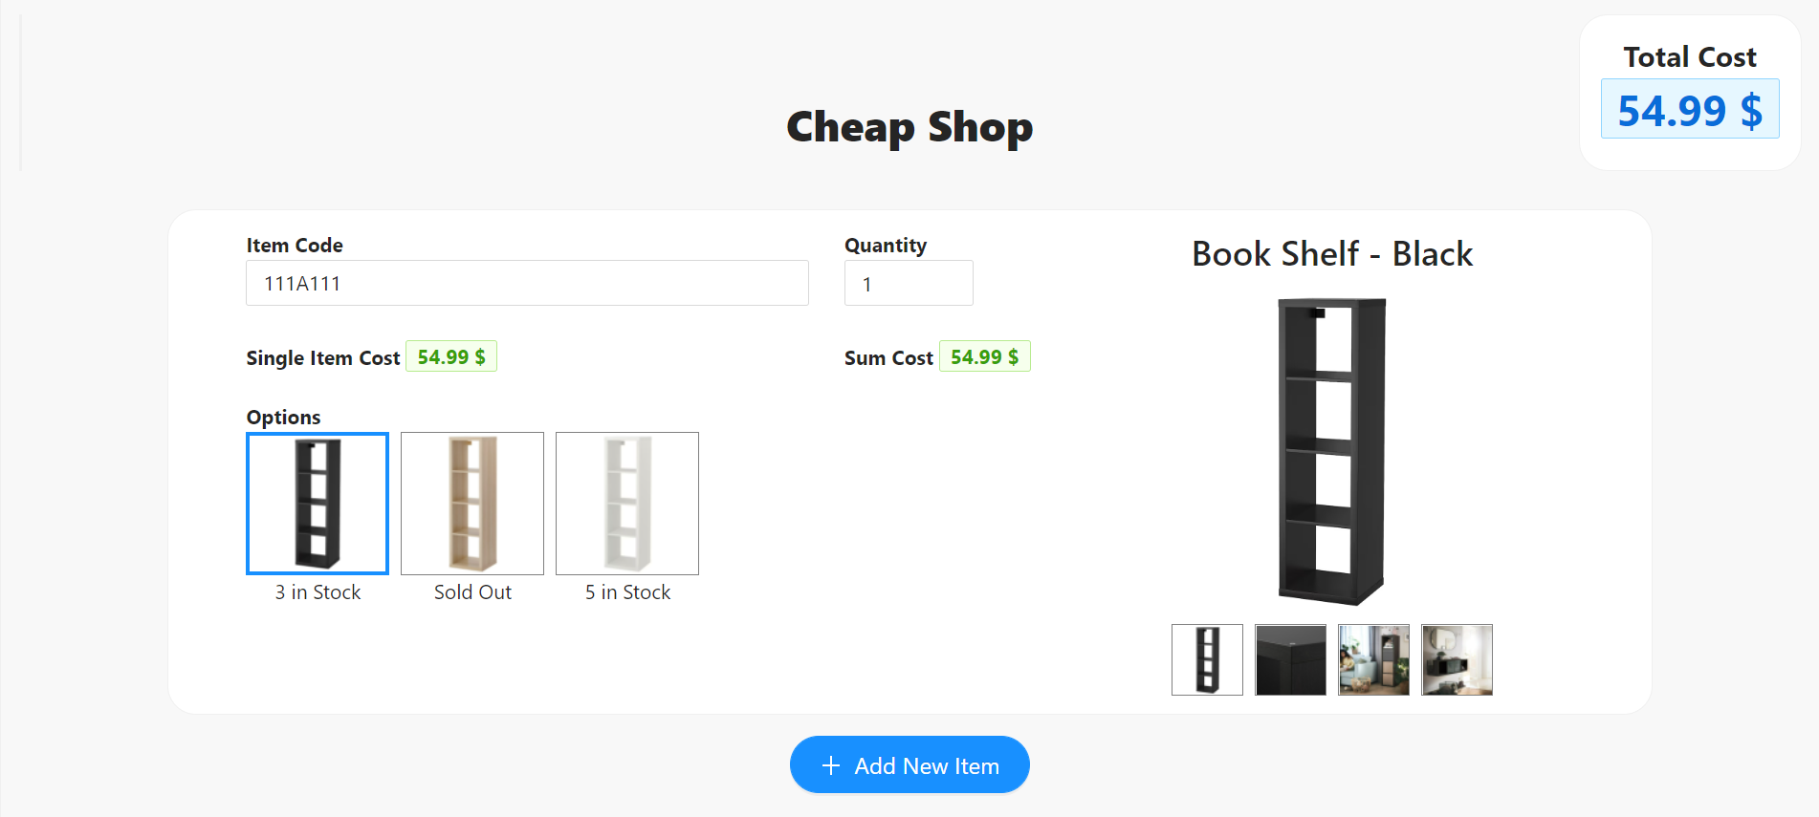
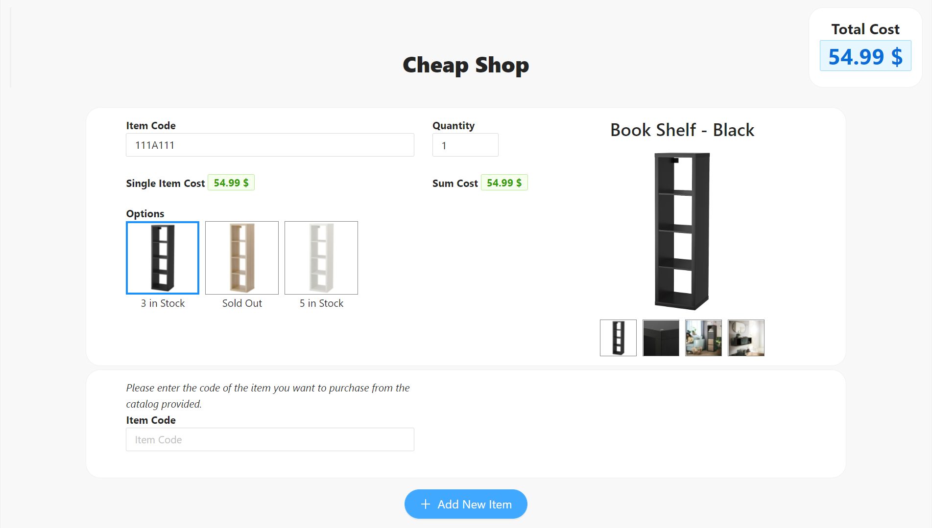
Adding Items
We can add new items by clicking ‘Add New Item’ button.

Slide 7
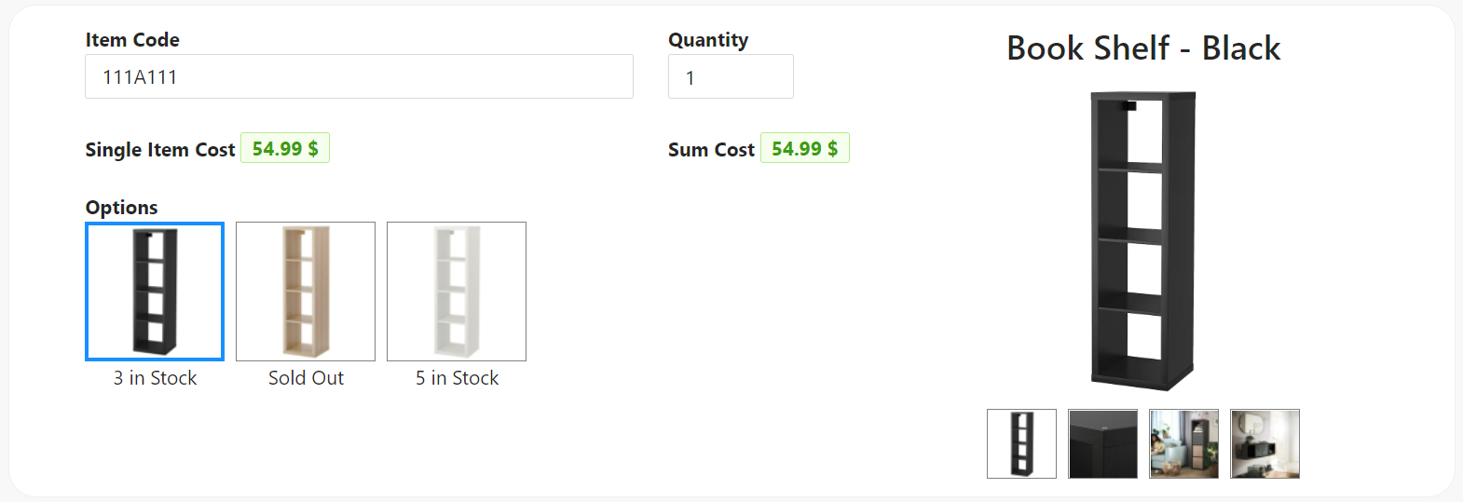
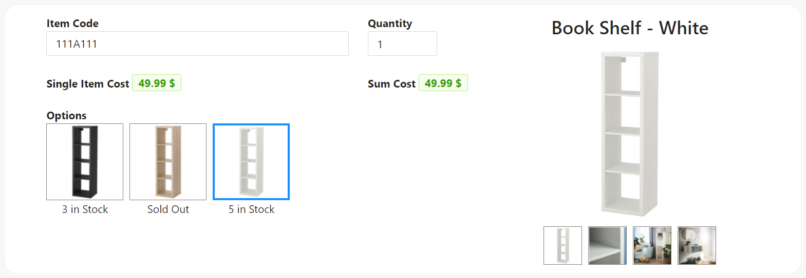
Selecting Options
We can select the available options of a product. We can’t select options that are sold out.
We can also see the price and images of the option selected.

Slide 8
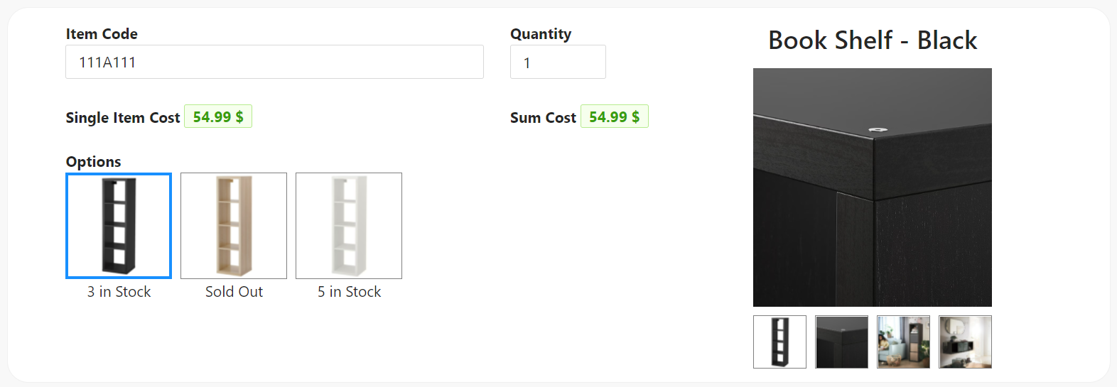
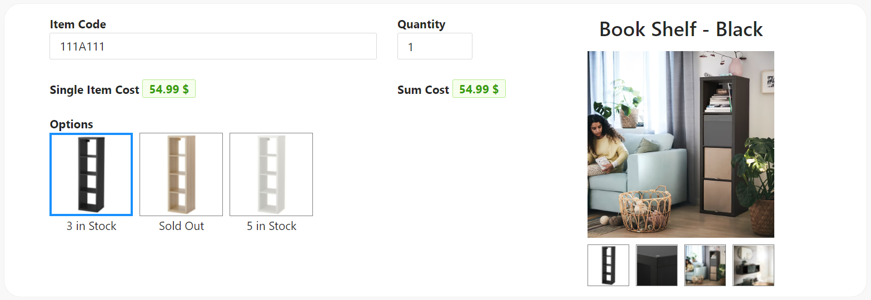
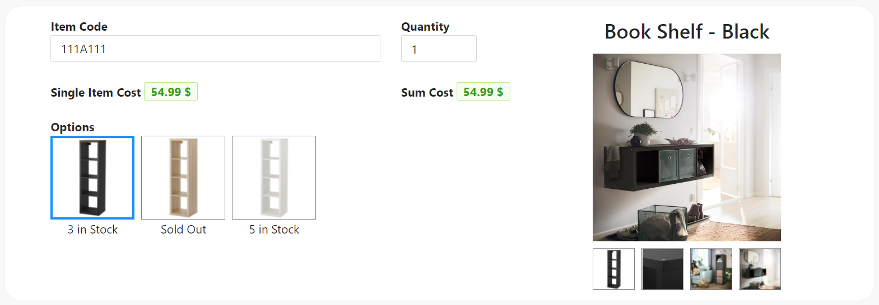
Selecting Images
We can view the images of the option of the product we have selected.

Slide 9
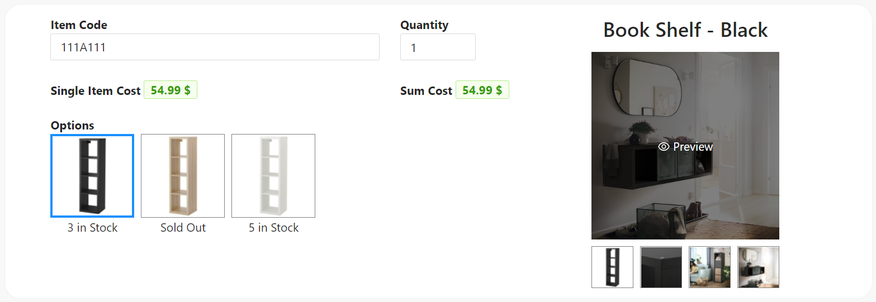
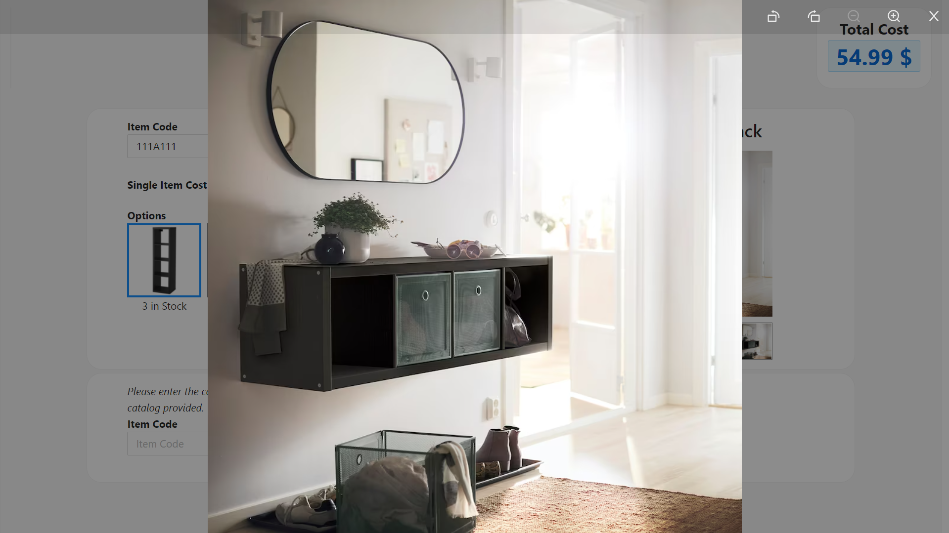
Previewing Images
We can preview and zoom into images by clicking on them.

Slide 10

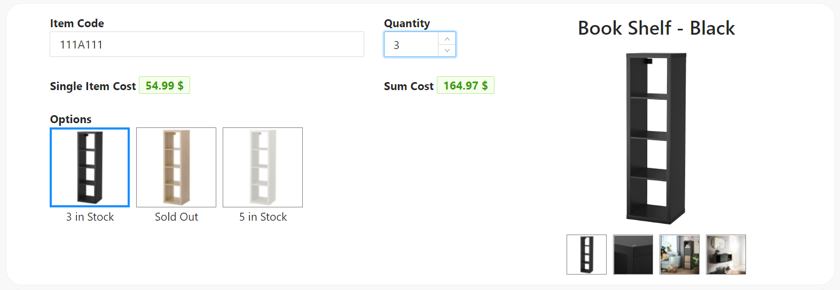
Changing Quantity
We can update the quantity of the items selected. The minimum quantity will be one and the maximum quantity will be the number of selected option in the stock. Total cost changes each time we update the quantity.

Slide 11
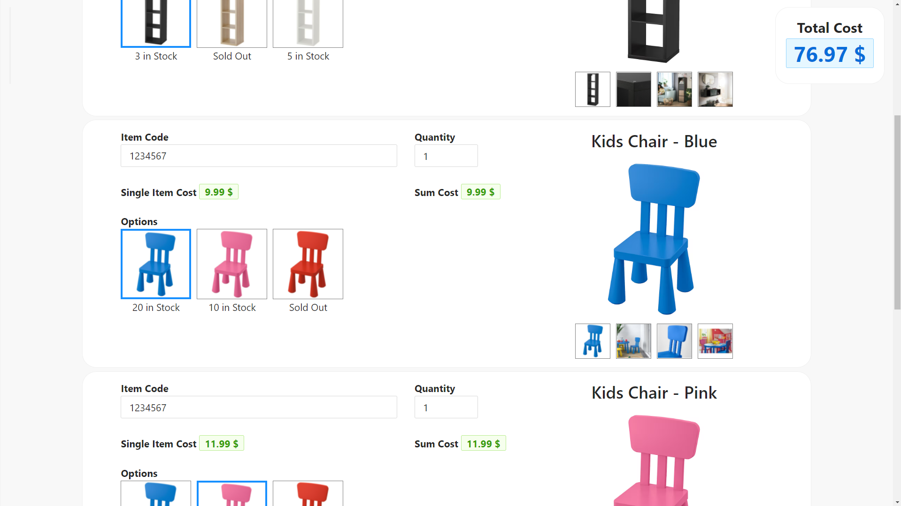
Total Cost
We can see the total cost of the items selected at the top of the screen, even if we had to scroll down.

Slide 12
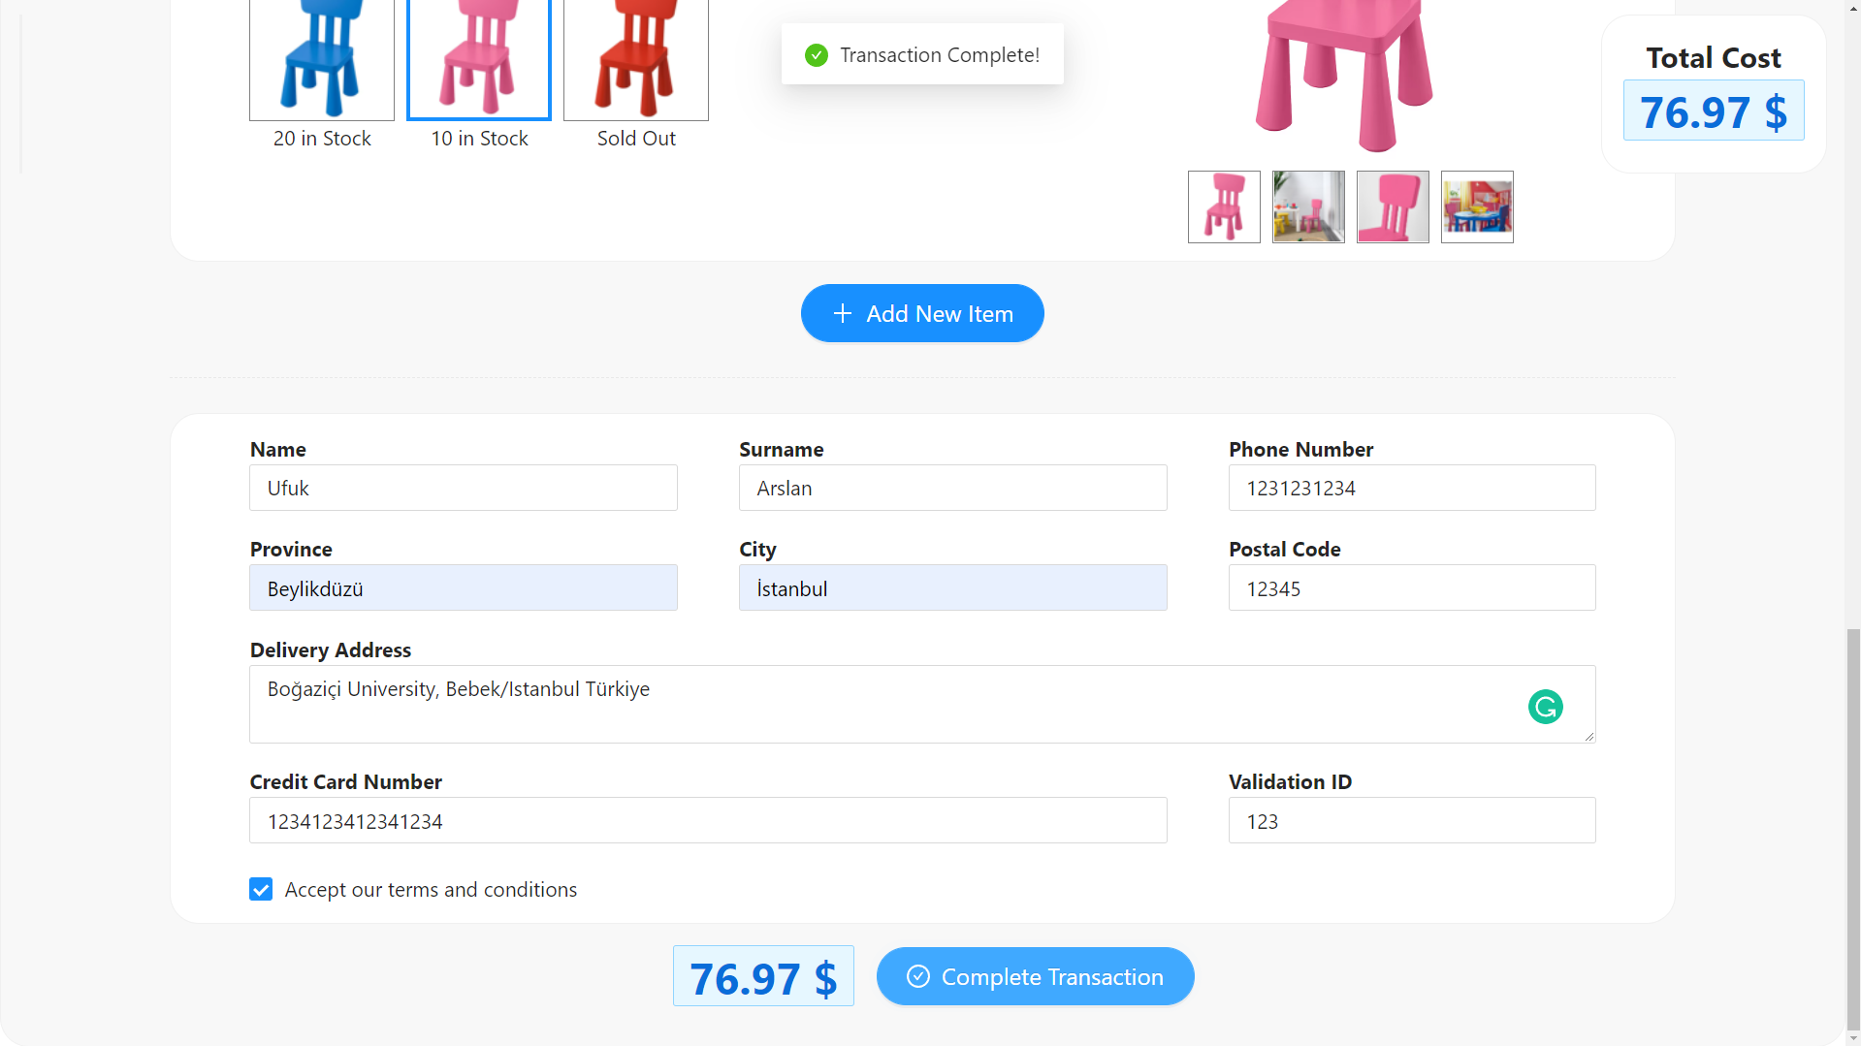
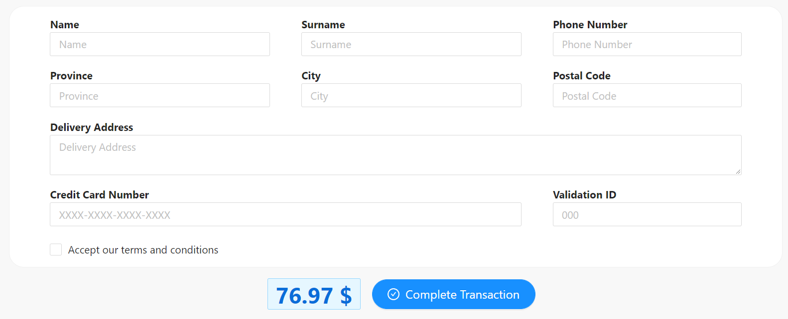
Payment Form
After selecting the products, we can fill in the payment form below. After clicking ‘Complete Transaction’ button we can see an acceptance message.

Slide 13
References
THANK YOU
IKEA product images:
https://www.ikea.com/us/en/cat/kids-chairs-18769/
https://www.ikea.com/us/en/p/kallax-shelf-unit-white-00275848/
React: https://reactjs.org/
Ant Design: https://ant.design/

